Slide 1
Nautical Information Provision Working Group (NIPWG)
Update on S-100 Registry interface and Test operation
KHOA / IHB
Notes:
would like to report on the result of improvement to S-100 Registry interface currently in process and future plans.

Slide 2
Content
Background
Improvement
Test operating
Plans

Slide 3
Background
Revised S-100 version 2.0
GI register proposal process to S-99
Report on improvement of S-100 Registry interface and future plans

Slide 4
Improvement of S-100 Registry
Steps to develop new S-100 Registry interface(FCD register only)
  NOAA to establish a clone server of S-100 registry and clean the DB
  KHOA to reflect the requirement for interface analyzed by NOAA
  KHOA to transfer the KHOA registry to the IHO clone server and start test operating the S-100 registry
  Domain manager to use the S-100 FCB to test produce the S-10x FC
Notes:
The KHOA developed following strategies to establish the S-100 Registry stably and effectively

Slide 5
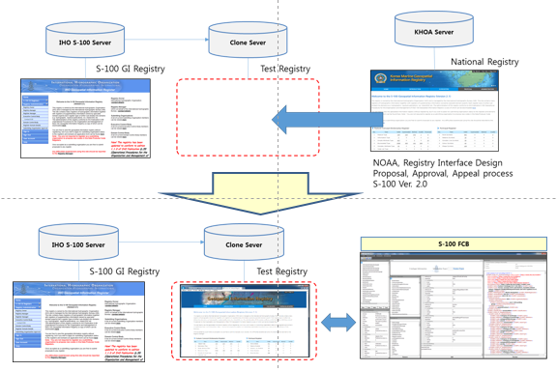
Improvement of S-100 Registry(Cont.)
Work process

Slide 6
Improvement of S-100 Registry(Cont.)
The current IHO S-100 Registry (the FCD Register only)
  The FCD Register, Data Producer Codes Register, and Product Specifications Register have been created.
  The code list type and code list value newly included in S-100 Ver. 2.0 are missing.
  Part of the proposal process is missing.
  Incomplete approval process
  Incomplete appeal process
  Incomplete Registry user management system

Slide 7
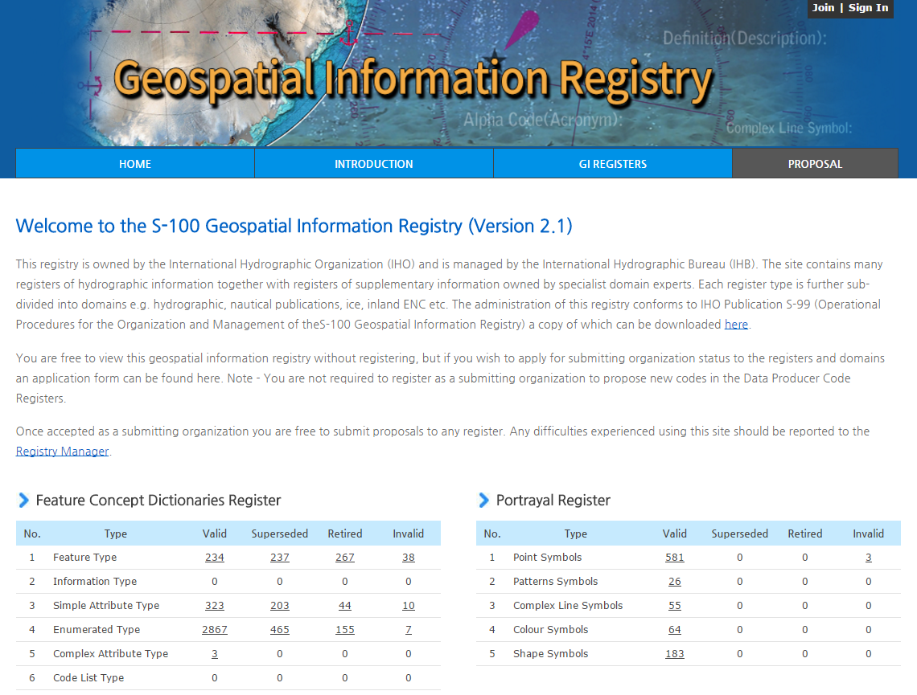
Improvement of S-100 Registry(Cont.)
NEW IHO GI registry

Slide 8
Test operating the S-100 Registry
Validate the improvement to the S-100 Registry interface and proposal processes
  Hydro domain, Npub domain, Inland ENC domain
  Registry Manager
  FCD register manager
  Domain control body
  Submitting organization

Slide 9
Plans for the S-100 Registry
The KHOA agreed with the IHO on the improvement to and stabilization of the S-100 Registry
  KHOA plans to complete the test operation, transfer the Registry to an IHO server, and start operating it from Middle of 2016.

Slide 10
Plans for the S-100 Registry (Cont.)
KHOA support 2nd development project
  Develop Portrayal Register interface
  Metadata Register
  Data Producer Codes..??
  Product Specifications

Slide 11
Action required of S-100WG1
The S-100WG1 is invited to:
  note the progress reported in this paper.
  Invite relevant experts for developing the second phase of the S-100 Registry

